Slide 1
Noncompliance Reporting and FOIA
Marilyn Brown, Jessi Kittel, Jane Na, David Powell, Bridget Watson
ICARE TTI
May 4, 2017
Facilitators: Carolyn McKinnie, Chris Newcomer
Welcome, IACUC Members!

Slide 2
Goal #1
Understand the concept of noncompliance and how and why we report
Session Objectives
Define noncompliance (LOC)
Assess whether events are noncompliant (HOC)
Outline noncompliance reporting requirements of OLAW & USDA (HOC)
Predict possible outcomes of reporting noncompliance (HOC)
Justify why we report noncompliance (HOC)

Slide 3
Goal #2
Understand the impact of the Freedom of Information Act (FOIA) as it relates to Noncompliance Reporting
Session Objectives
Recognize appropriate content of a noncompliance report and what can make it FOIA ready (LOC)

Slide 4
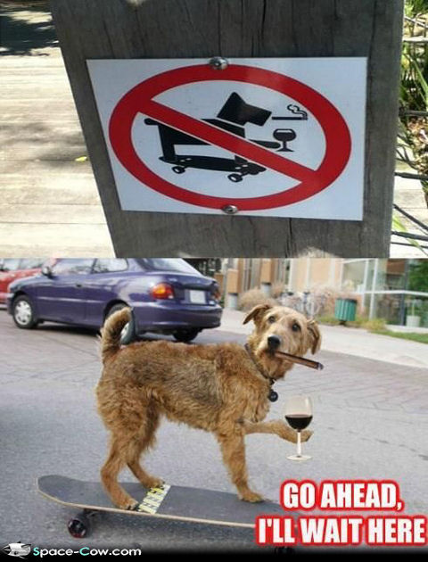
Define noncompliance
THINK
↓
PAIR
↓
SHARE
Notes:
10 minutes

Slide 5
Define noncompliance
Did your answer change after consulting with your partner? With your group?
How?

Slide 6
Is it noncompliance?
An investigator discontinues administration of buprenorphine two days after surgery as they determine the animal is no longer in pain. The protocol describes that buprenorphine will be administered through the third post-operative day.
Polling - using your voting cards, indicate Yes (green card) or No (red card)?
Why?

Slide 7
Is it noncompliance?
An investigator is not following the institutional policy for aseptic technique. Upon investigation, the deviation is in the IACUC approved protocol with appropriate scientific justification.
Polling - using your voting cards, indicate Yes (green card) or No (red card)?
Why?

Slide 8
Noncompliance reporting requirements
NIH Office of Laboratory Animal Welfare (OLAW)
PHS Policy Section IV.F.3. Reporting Requirements (TABLE 1)
NIH Prompt Reporting to OLAW NOT-OD-05-034 (TABLE 3)
OLAW Noncompliance Reporting Final report section (TABLE 4)
U.S. Department of Agriculture (USDA)
Tech Note (TABLE 5)
Notes:
Institutions must provide a final report of reportable situations that includes a detailed explanation of the circumstances and actions taken.

Slide 9
Noncompliance reporting requirements
Review your table’s assigned resource document and put together a summary
Peer teaching - rotate who presents your summary each time
Table 1 + Table 3 Table 4 + Table 5
Table 1 + Table 4 Table 3 + Table 5
Table 1 + Table 5 Table 3 + Table 4

Slide 10
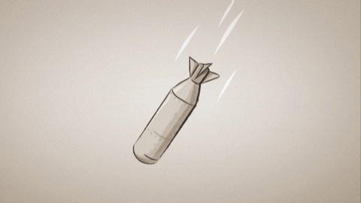
What happens when we report noncompliance?

Slide 11
What happens when we report noncompliance?
Your IACUC has become aware that during a recent windstorm, power was knocked out to your animal facility housing a large colony of rabbits on a PHS-funded study. The emergency generator failed and power was not restored for 48 hours. During this time, temperatures exceeded the maximum allowed in the Guide and AWA Regulations. Your IACUC convenes an emergency meeting and decides this must be reported to the USDA and OLAW. Predict how this would play out.
Brainstorm - as a group, think of possible outcomes of reporting this noncompliance
Concept map - demonstrate these outcomes and how they may interact

Slide 12
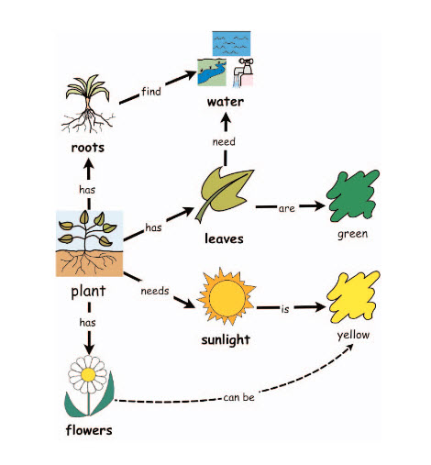
Sample Concept Maps
http://www.readingrockets.org/strategies/concept_maps
Notes:
Photosynthesis slide

Slide 13
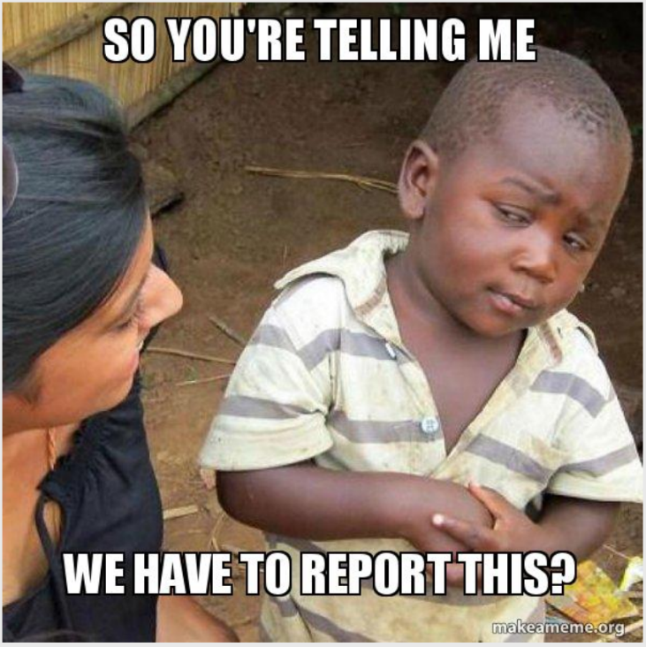
Why do we report noncompliance?
Brainstorm - at your table, discuss and come up with one or two reasons why we report noncompliance
Report out

Slide 14
Why do we report noncompliance?
Consensogram - take two post-its and vote for the two reasons that you deem most significant

Slide 15
What goes into a noncompliance report?

Slide 16
What goes into a noncompliance report?
Review this excerpt from a noncompliance report which includes the description of the incident and corrective action. Keep in mind that these reports may be subject to FOIA.
Work on this individually for a couple minutes, discuss as a table – what would you change and why?

Slide 17
ACCOMPLISHMENTS
Goal #1
Understand the concept of noncompliance and how and why we report
Objectives
Define noncompliance (LOC)
Assess whether events are noncompliant (HOC)
Outline noncompliance reporting requirements of OLAW & USDA (HOC)
Predict possible outcomes of reporting noncompliance (HOC)
Justify why we report noncompliance (HOC)

Slide 18
ACCOMPLISHMENTS
Goal #2
Understand the impact of the Freedom of Information Act (FOIA) as it relates to Noncompliance Reporting
Objectives
Recognize appropriate content of a noncompliance report and what can make it FOIA ready (LOC)

Slide 19
Summative Assessment
1. Assess each as a non-compliant incident. For purposes of this question, all described animal activities are funded by PHS. Mark Y (yes) or N (no). 1 point each for scoring criteria (4 out of 5 points constitutes objective met).
____ An investigator discontinues administration of buprenorphine two days after surgery as they determine the animal is no longer in pain. The protocol describes that buprenorphine will be administered through the third post-operative day.
____ The protocol is approved for 800 zebrafish. The PI exceeds use of animal numbers approved on the protocol by 150 zebrafish.
____ An investigator is not following the institutional policy for aseptic technique. Upon investigation, the deviation is in the IACUC approved protocol with appropriate scientific justification.
____ An animal is found alive in the carcass cooler.
____ A PI has protocol approval to have animals within laboratory space for up to 18 hours. During the semiannual inspection, upon questioning the postdoctoral fellow, it is disclosed that animals are kept for up to a week in the lab.

Slide 20
Summative Assessment
2. Is the scenario below reportable to OLAW (O), USDA (U), both (B), or neither N)? 1 point each for scoring criteria (5 out of 6 points constitutes objective met).
__ An investigator discontinues administration of buprenorphine two days after surgery as they determine the animal is no longer in pain. The protocol describes that buprenorphine will be administered through the third post-operative day.
__ The protocol is approved for 800 zebrafish. The PI exceeds use of animal numbers approved on protocol by 150 zebrafish.
__ An investigator is not following the institutional policy for aseptic technique. Upon investigation, the deviation is in the IACUC approved protocol with appropriate scientific justification.
__ A guinea pig is found alive in the carcass cooler.
__ A PI has protocol approval to have hamsters within laboratory space for up to 8 hours. During the semiannual inspection, upon questioning the postdoctoral fellow, it is disclosed that animals are kept for up to a week in the lab.
__ An IACUC reviews and votes to suspend an animal activity.

Slide 21
Summative Assessment
3. List three negative and three positive outcomes of reporting noncompliance. Must list three negative and three positive to meet the objective.
4. Which of the following supports why we report noncompliance to regulatory agencies (select all that apply) (Must identify the two that apply to meet objective.)
Retaliation against a difficult investigator
Validate the principle of self-regulation
Could be a mitigating factor in regulatory investigation and enforcement
Flex the IACUC’s muscle

Slide 22
Thank you for your participation!

